Slide 1
(Name)
Digital Passport

Slide 2
Acknowledgements
We have had lots of help and support putting this passport together and want to say a huge thanks to:
Mandy and Teresa for their advice from a family perspective.
Katy Evans for her expertise around postural care, communication and language.
Sarah Clayton https://www.simplestuffworks.com and Sharon Sutherland https://www.postureandmobility.com for putting together the postural care section of the passport and for providing the films that accompany it.
PAMIS a family carer led charity for advice on developing the passport.
NHSE for funding the project.
Saxon Hill Academy for working with us on the pilot project.

Slide 3
How to use this passport
Please use this passport in a way that works for you. Not everyone will need all the sections. You can delete slides or sections that don’t work for you. If you need extra slides you can add them in by duplicating the slide.
Please don’t feel you need to complete the passport all in one go. The passport is a big document and it will take time for you to think about and complete. It can be done in stages, at your own pace, in a way that works for you.
The link below takes you to some short “how to” films which explain how to use the passport, add a slide, insert photos, films or links to files, change the layout of the slide etc.
Click here to watch film

Slide 5
CONTENTS
Emergency
How to support me
Me and my family
People who help me
How I communicate

Slide 6
Me
This section lets you know:
Important things about me that you might need to know in an emergency
Things I want you to know about me and my life
What makes me happy and unhappy
Things I want you to know about my family and friends

Slide 7
Who am I?
This is your chance to introduce the person as you know them.
Describe their personality and what makes them tick.
Share photos / films that show who they are.

Slide 8
Who am I?

Slide 9
Important things you need to know
Name (including what the person prefers to be called)
Date of Birth
Address
Who the person lives with
Next of kin (and phone number)
Main contact (and phone number)
NHS number
Include anything else that would be essential for someone to know in an emergency situation (i.e hospital admission) This may include allergies, medication (including brand if this is important). You can add a link to any support plans if this is helpful. You can also add extra slides if you need to. See the films on slide 3 for how to do this.

Slide 10
Important things you need to know

Slide 11
Things that make me happy
To help to build a picture of the person, include information about what makes them happy. Include things that they like but also think about places they enjoy being or visiting and people they enjoy spending time with.
Include as much detail as possible and use photos and films to help. For example, if it’s about music, insert a clip of their favourite song or band playing.

Slide 12
Things that make me happy

Slide 13
Things that make me unhappy
Share things that make the person unhappy. This may be things they don’t like, things they don’t like doing, situations they don’t like to be in, times of day, something they miss if it doesn’t happen…

Slide 14
Things that make me unhappy

Slide 15
My family and friends
Use this slide to share any information about the person’s family and friends that they may want to share.

Slide 16
My family and friends

Slide 17
How I communicate
This section lets you know:
How I let you know how I’m feeling
How I let you know what I want
How you know I am in pain or distress
How to connect with me
What it looks like when I’m communicating

Slide 18
When I am feeling…………
You may want a separate slide for different emotions.
Include information about when the person is happy, sad, angry, bored or fed up, upset, tired, anxious. Photos are particularly helpful. You might want to include information about how emotions affect the person’s posture. For example
When I am stressed and anxious my muscle tone increases and I find it harder to move.

Slide 19
When I am feeling…………

Slide 20
When I want or need something
Include information about how the person lets you know they need or want something i.e:
a drink, the toilet etc.
How they get someone’s attention.
How they indicate “yes” or “no”.
How they let you know they want to go somewhere else, be moved or go to bed.
Include information about how the person makes choices and what people need to do to make sure this happens.
You may want to include photos or films of gestures the person may make.

Slide 21
When I want or need something

Slide 22
When I am in pain or distress
This is crucial information to share in a passport. Family carers often instinctively know when someone is in pain or distress. How can you best share this information?
Consider using photos showing the person when they are relaxed or happy next to one when they are in distress or pain so there is a direct comparison. Include as much detail as possible in any descriptions that you use.

Slide 23
When I am in pain or distress

Slide 24
Getting to know me
Use this slide to describe how someone can start to get to know and build a relationship with the person so that they really connect with them.
Include information about any communication systems people should use to support them. If the person uses a communication device you could add a link to the manual or include a film showing how to use it.
Include suggestions of good ways to start a conversation or interaction. Is it just by sitting and spending time with them in silence, is it through sensory communication, is it through looking at photos with them, sharing a sensory story, listening to music together…?
Think about when and where this might happen.
What are their interests that someone may share ( a sports team they support, a favourite place they love to visit, a band they love…)?

Slide 25
Getting to know me

Slide 26
Watch me communicate
Include films, where possible, that show the person communicating with someone they care about and have a connection with, for example; intensive interaction, using a signing system, objects of reference, talking mats, sensory communication. You may want to include films from different settings, home, day service, school, short breaks, with friends etc.

Slide 27
Watch me communicate

Slide 28
How to support me
This section includes information about my:
Postural care
You may choose to share information about other things in this section
My posture
When I am lying down
When I am sitting
When I am standing

Slide 29
Postural Care
Disclaimer: the person should only let people touch them for postural care support if they feel comfortable with this. There will be some occasions when the person is working with their therapist or being fitted for a chair where people will need to touch them, but people should always ask the person’s permission before touching them and they should always explain what they are doing.
You may want to include information here about how a professional can best explain what they are going to do and how they can know whether the person is happy or not happy with it.

Slide 30
My posture
This section is all about the equipment and positioning that is used to keep the person safe and comfortable.
Think about and include why this is important to the person, for example:
I find it hard to change position without help from someone else.
Most people can change position when they are uncomfortable, and I need some help to do this.
If I am in one position for a long time it will become uncomfortable and even painful.
My body is soft and if it isn't supported well can change shape because of gravity.
When I am excited, upset or experiencing any change in emotion, my muscles make my posture change.
I get red marks on my skin when my posture is not well supported.
I only have one body, so we all need to take good care of it as much as possible.
Click here to watch film

Slide 31
My posture

Slide 32
My body shape
Use this section to describe the person’s current body shape. Any changes that may have taken place such as curvature of the spine, hip dislocation or changes in chest shape.
If you have any reports from Physios or OTs it would be helpful to link them to this slide. Watch the film on slide 3 for help on how to do this.
As well as highlighting the person’s body shape it is also helpful to describe the impact that their body shape has on their life.
Does is cause them to have more health problems, to tire easily, to experience pain? Does it affect their body image and self esteem?
Click here to watch film

Slide 33
My body shape
.

Slide 34
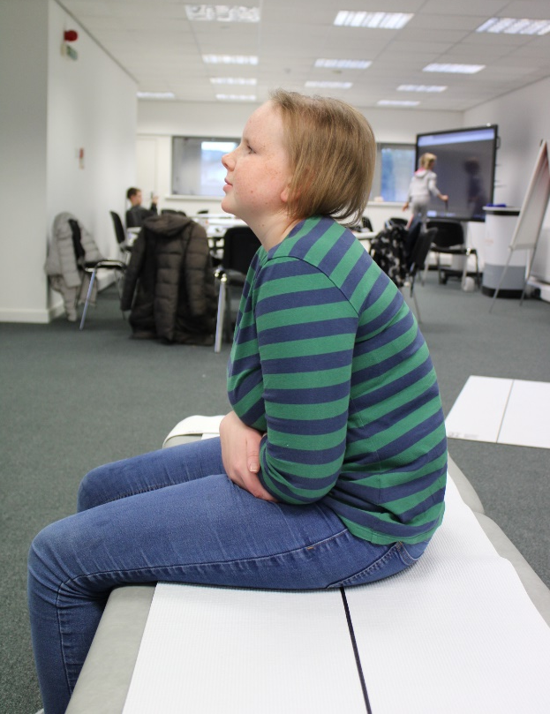
My body
If you have any photographs that show the person’s body shape, they can be used here. You might want to point out things on the photograph that people need to be aware of, for example:
I tilt my head back so that I can correct my vision. If I am wearing my glasses, I don’t do this!
Click here to watch film 1
Click here to watch film 2

Slide 35
My body

Slide 36
My body
A really important part of the body that is often overlooked, and covered up, is the chest. Use this slide to record the person’s chest shape. It may be that the person is clothed when you take the photograph, in which case you can put your finger onto their sternum (the breastbone, where the ribs come together at the front).
My sternum is in the centre / to the left / to the right of my chest.
My ribs are the same / different on either side of my chest.
The bottom of my ribs and the bony bits (ASIS) at the front of my pelvis are / are not parallel.
Click here to watch film

Slide 37
My body

Slide 38
What are my postural care goals
Use this slide to record what the person is hoping to achieve from their positioning. The following list might be helpful but the person and those that know them best will have lots of ideas of their own:
I would like to be comfortable during the day and night
I would like to protect my body shape
I would like to be able to enjoy activities in my chair for longer
I would like to protect my chest health
I would like to feel safe, secure and well supported
Think about how you can check if these goals are being met.
Click here to watch film

Slide 39
What are my postural care goals

Slide 40
How I feel about my assistive technology/equipment
Use this slide to record any feedback that the person can share about how their assistive technology/equipment and positioning makes them feel.
Think about sitting, standing and lying.
It might be helpful to share a film of the person to demonstrate how they communicate that they are comfortable and happy.
Equally it is important to share any information that can help people to see that the person is unhappy or uncomfortable.
Is there anything the person likes to do whilst using their equipment.
Do they like to have someone with them ?
Click here to watch film

Slide 41
How I feel about my assistive technology/equipment

Slide 42
When I am lying down
Use this section to describe the support that the person needs when they are lying down.
What equipment is used?
How is it used?
How long is it used for?
Is it only used at night? What about during the day at school?
Are there times when it should not be used?
How does the person respond when they are well supported?
Do you have the contact details for the supplier / service provider should there be a problem?
Click here to watch film

Slide 43
When I am lying down

Slide 44
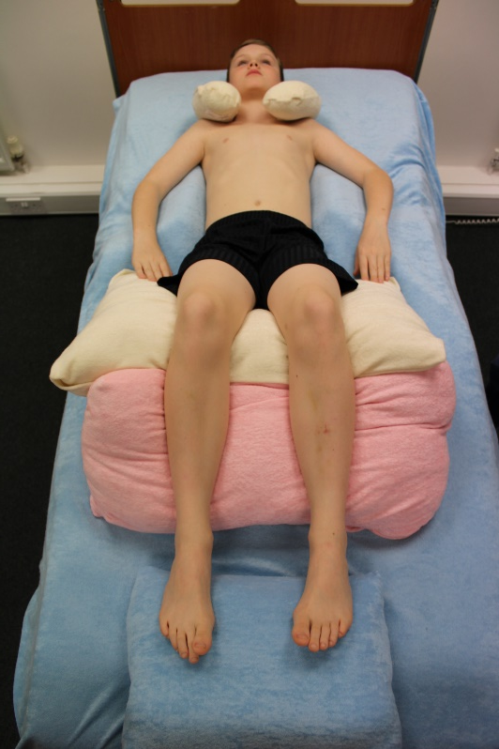
When I am lying down
It may be helpful to see how the person lies when they have no support and how they lie with support.
Click here to watch film

Slide 45
When I am lying down

Slide 46
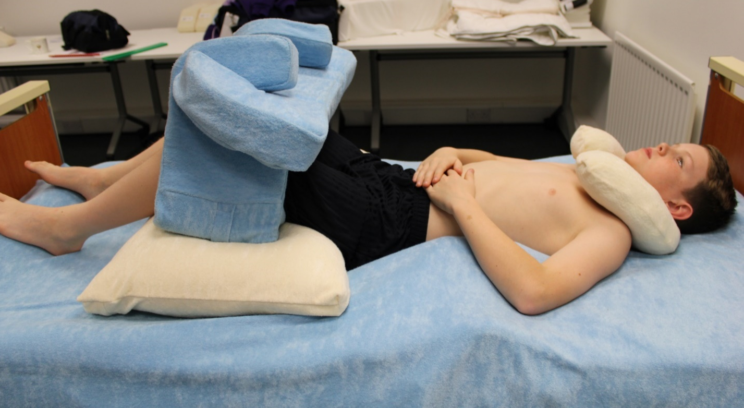
When I am lying down
Share any photographs that help people to understand what goes where. If the person uses specialist equipment it would be helpful to show how the equipment is used, any fixings and so on.
Click here to watch film 1
Click here to watch film 2

Slide 47
When I am lying down

Slide 48
When I am lying down
It may be helpful to work from top to toe, starting at the person’s head.
I use a neck support pillow. This stops my head falling backward which might make it difficult for me to swallow. The support also keeps my head in the middle.
Click here to watch film

Slide 49
When I am lying down

Slide 50
When I am lying down
Moving down to the support they use at the chest.
I have supports at my chest and hips to keep me snug and secure.
The supports are held in place between the layers of mesh on my mattress.
Click here to watch film 1
Click here to watch film 2

Slide 51
When I am lying down

Slide 52
When I am lying down
Their legs…
I use a stabiliser to support my legs.
The stabiliser is raised on a pillow – you can check it is high enough by feeling underneath my lower back and checking that I make good contact with the bed.
Click here to watch film

Slide 53
When I am lying down

Slide 54
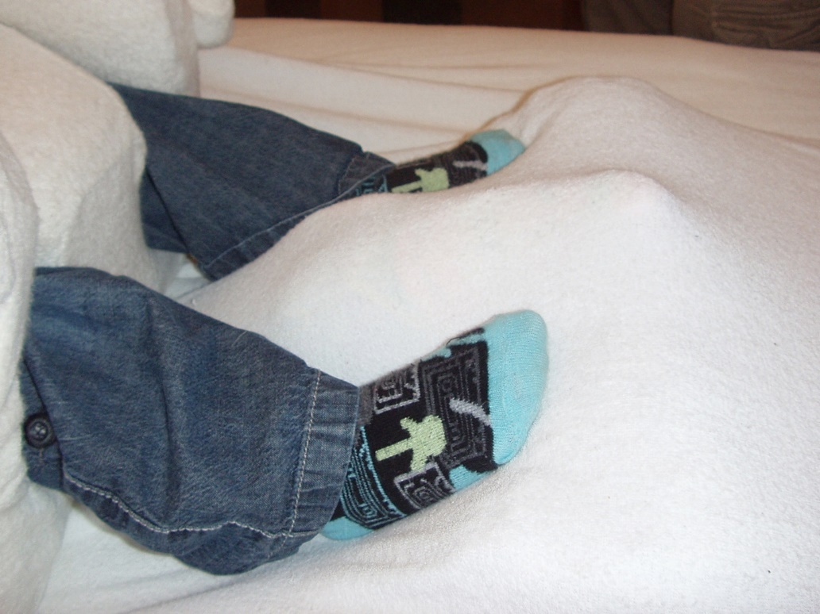
When I am lying down
And finally, my feet.
My feet need support too.
I use a pillow underneath the soles of my feet to stop them dropping forward.
I have a rolled up towel to stop my feet coming together.
There is a gap underneath my heels to stop them from getting sore.
Click here to watch film 1
Click here to watch film 2

Slide 55
When I am lying down

Slide 56
Changes of position
Use this slide to document any changes of position that are needed during the night.
How often does the person usually need a change of position?
How do they let you know that they need to move?
Is the equipment removed completely or is it rearranged?
What does this new position look like?
Does anything else need to happen once the person is repositioned, a night light, music, removal of blankets for example?
Include a film showing a change of position if you want to.
Click here to watch film

Slide 57
Changes of position

Slide 58
My safety when I am lying down
Use this section to describe any risks to the person when they are lying down. How do you make sure the person is safe? You might want to complete a safety checklist and link it to this slide.
The following list may help but you can add any other risks you feel people need to be aware of:
Is the person comfortable? Are there any pain issues that need to be resolved? Is their circulation affected in any way by the positioning being used? Do they have epilepsy? Can they breathe comfortably? Are they at risk of choking or aspiration? When will the support be put in place / removed? Can they control their own temperature? Have any potential new pressure areas been created with the new position?
Click here to watch film

Slide 59
My safety when I am lying down

Slide 60
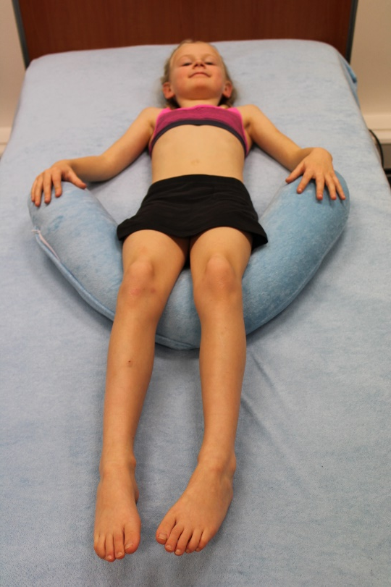
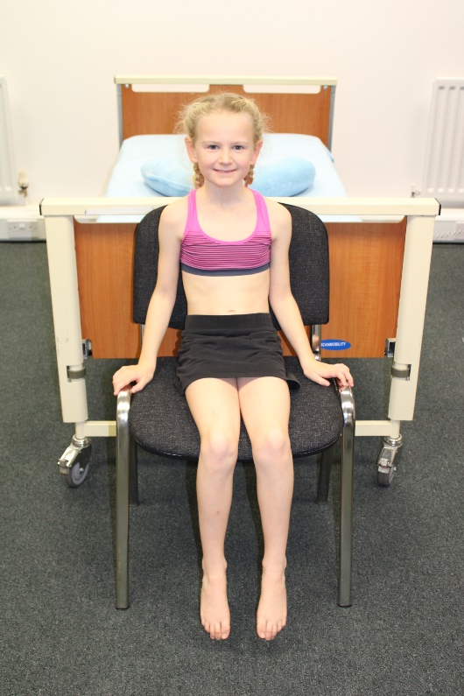
How I lie is how I sit
Use this final slide to help people to understand how my lying position is linked to my seating. Photographs from the end of the bed are really useful for this.
Click here to watch film

Slide 61
How I lie is how I sit

Slide 62
Sitting
The following slides are all about sitting and the equipment the person uses.
Include information about all of their different chairs or seating systems and where they use them.
How does the person feel about their chairs?
Why are their chairs important to them? What do they allow them to do?
What are the important things to know about their equipment?
How can people look after their chairs or seating systems?
Click here to watch film 1
Click here to watch film 2

Slide 63
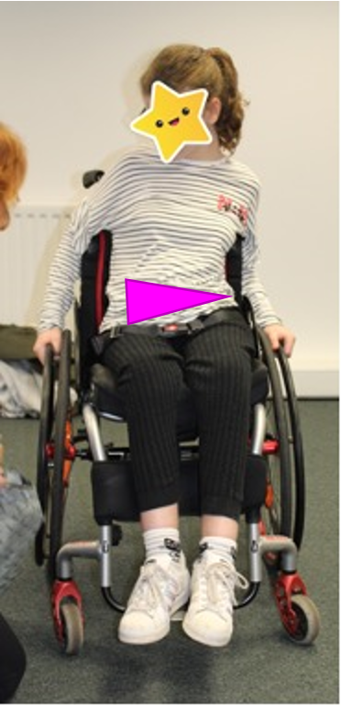
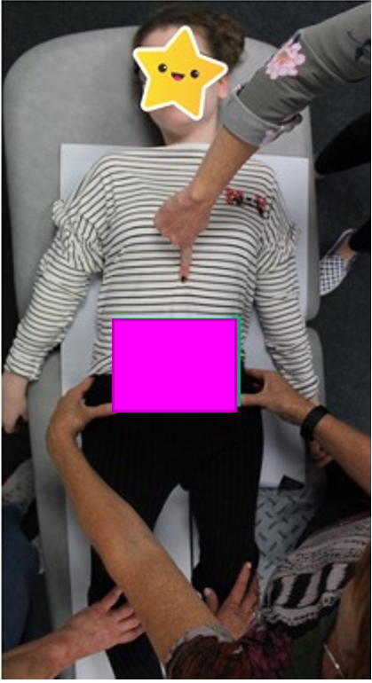
My body in sitting: What is the shape of my life box? My life box is the shape between my lower ribs and my pelvis from the front.
This is my life box in sitting
In comparison to my life box in lying
Click here to watch film

Slide 64
When I am sitting- The assistive technology/equipment
Use this section to describe the support/s that the person needs when they are sitting in their wheelchair, activity chair or comfort chair.
Photographs of the equipment are really helpful (both with and without the person using it!)
What seat cushion or seat support is used?
What back cushion or back support is used?
Is there a head support used?
Where do the person’s feet need to be supported relative to their knees?
You may want to use different slides for different parts of the body as in the lying slides.
You can include the contact details for the service provider / supplier of the equipment.
Click here to watch film

Slide 65
When I am sitting- The assistive technology/equipment

Slide 66
When I am sitting
You may want to include photos from different angles that show how the person should be comfortably positioned in their chair (s).
What should people look for to make sure the person is comfortable?
Where does their body make contact with the chair and are there any gaps?
You can use arrows to point things out that are important. See link on slide 3 to learn how to do this.
Click here to watch film

Slide 67
When I am sitting

Slide 68
When I am sitting – additional support
Use this section to describe any additional support/s that the person needs when they are sitting in their wheelchair, activity chair or comfort chair.
What positioning straps or harnesses are used and where?
You may want to include photos.

Slide 69
When I am sitting – additional support

Slide 70
When I am sitting – my head
If the person uses a head support include a photo that shows how the person’s head should be supported.
Explain or show how to adjust the head support if needed.

Slide 71
When I am sitting – my head

Slide 72
When I am sitting – my legs
It is important that my legs are in the right position as this affects the shape of my life box. Click here to watch a short film about this.
Include photos that show how my legs should be positioned when I sit in my chair(s).
Click here to watch film

Slide 73
When I am sitting – my legs

Slide 74
When I am sitting – my feet
You might want to include a photo of the person’s feet and foot supports.
Explain what someone should look for to make sure the person’s feet are in the right position.

Slide 75
When I am sitting – my feet

Slide 76
When I am sitting – at school
Use this section to describe any differences in the support/s that is available to the person in different settings.
Is the same seating used at home and at school?
Are there any differences when the person accesses short break settings or hospital?
You can add a slide in for each different setting (i.e home, school, short breaks, work, college etc.) or for each different chair. Don’t forget to change the title of the slide.
Click here to watch film

Slide 77
When I am sitting – at school

Slide 78
When I am sitting - Transfers
Use this section to describe how the person is transferred into their wheelchair, activity chair or comfort chair. You can include a film
How does the person respond when they are not positioned well after being transferred into their seating?
How does the person respond when they are well supported?
Is a sling used? (include a photo) Is the sling left under the person all day?
Does the chair need to be in a particular position, tilted back for example, for a successful transfer?
Include any top tips, for example:
My feet get in the way when I am hoisted. Explain how to manage this or include a film.
Click here to watch film

Slide 79
When I am sitting - Transfers

Slide 80
When I am standing
If the person uses a standing frame you may want to include photos of them using it.
You may want to include information about:
how they feel about spending time in their frame,
how long they use it for,
what position it should be in,
what they like to do while they are using their frame.
You may want to include a short film showing how to set the standing frame up and how to transfer the person into and out of the frame. How will someone know that the person is correctly supported in their frame?
Include details of whoever is responsible for maintaining the frame. Include details of the make and model.

Slide 81
When I am standing

Slide 82
How you know I am uncomfortable
Use this slide to describe or show what people should look for to know whether the person is uncomfortable when using any of their equipment.

Slide 83
How you know I am uncomfortable

Slide 84
My progress
Use this slide to record the person’s progress in whatever way you choose.
This could be body measurements, goals they have achieved, length of time they use different equipment for…

Slide 85
My progress

Slide 86
People who help me
Include pictures of people who help me and what they help me with.
Include their contact details.
Make sure this section remains up to date

Slide 87
People who help me

Slide 88
This is the end of the passport. Click the home button to return to the contents page.
Click this link to access the full youtube playlist of postural care films
ask@changingourlives.org
www.changingourlives.org

